Slide 1
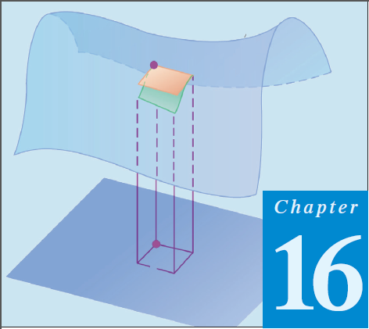
11
Thomas Calculus 12th (Chapter 16)
Calculus 9rd, Dale Varberg, Edwin Purcell and Steve Rigdon (C.14)
Surface Area and Surface Integrals
Samuel Lukas

Slide 2
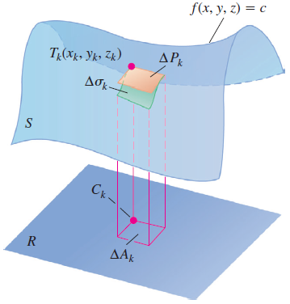

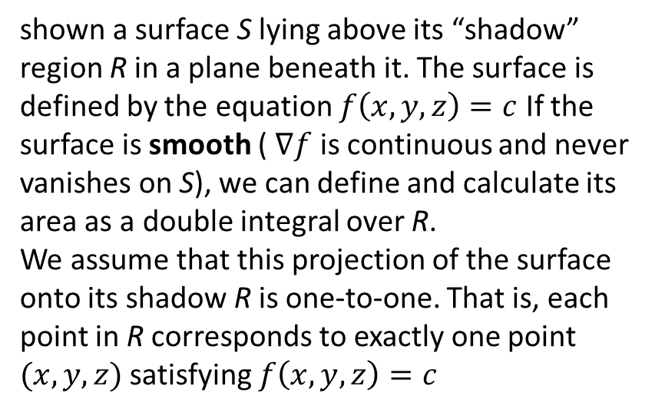
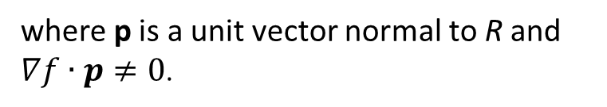
Surface Area
shown a surface S lying above its “shadow” region R in a plane beneath it. The surface is defined by the equation $f\left(x,y,z\right)=c$ If the surface is smooth ( $∇f$ is continuous and never vanishes on S), we can define and calculate its area as a double integral over R.
We assume that this projection of the surface onto its shadow R is one-to-one. That is, each point in R corresponds to exactly one point $(x, y, z)$ satisfying $f\left(x, y, z\right)=c$
where p is a unit vector normal to R and $∇f∙p≠0$.

Slide 3
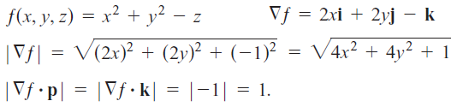
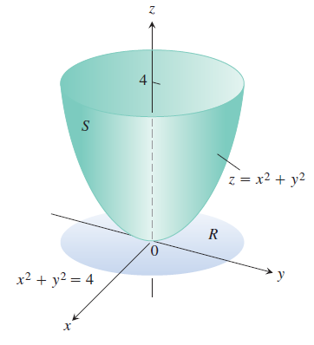



Examples 1
Find the area of the surface cut from the bottom of the paraboloid ${z=x}^{2}+y^{2}$ by the plane $z=4$

Slide 4
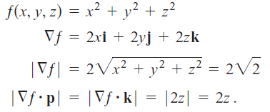
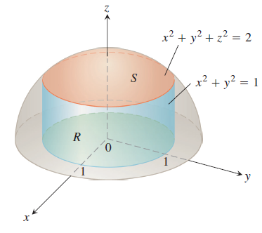




Find the area of the cap cut from the hemisphere $x^{2}+y^{2}+z^{2}=2, z≥0$ by the cylinder $x^{2}+y^{2}=1$

Slide 5
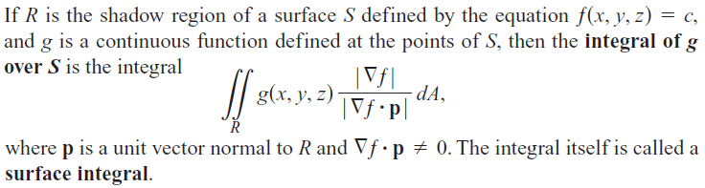
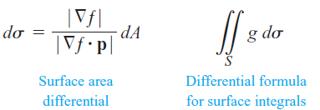

Surface Integrals

Slide 6
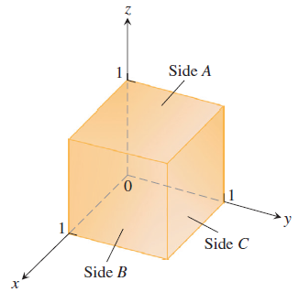
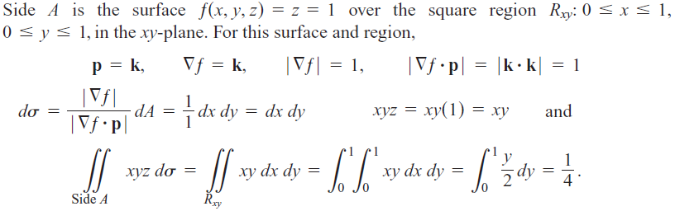
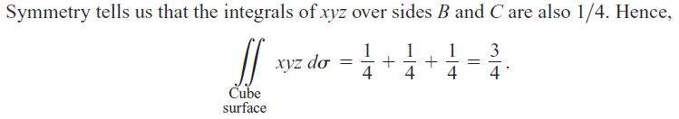
Examples 2

Slide 7
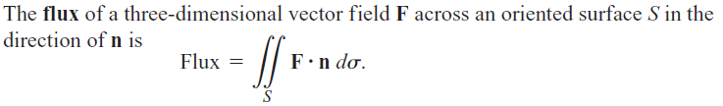
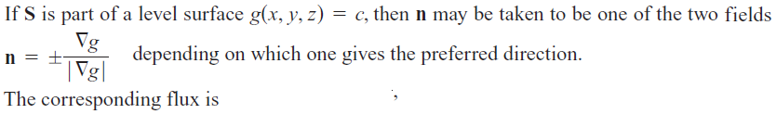


Surface Integral for Flux

Slide 8
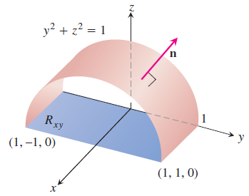




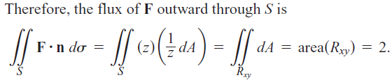

Slide 9


Exercises 1
1.
2.
3.
4.
5.

Slide 10




06.
07.
In Exercises 8 and 9, find the flux of the field F across the portion of the given surface in the specified direction.
08.
09.

